Slide 1
Cricket Analytics
Sachin Tendulkar Vs Virat Kohli

Slide 2
KPI’S Used for comparison
Runs per innings - Total runs / Total innings
SR Strike Rate - ( Total runs / Total balls)*100
Number of 100s and 50s
Teams contribution - (Player runs/Team Runs)

Slide 3
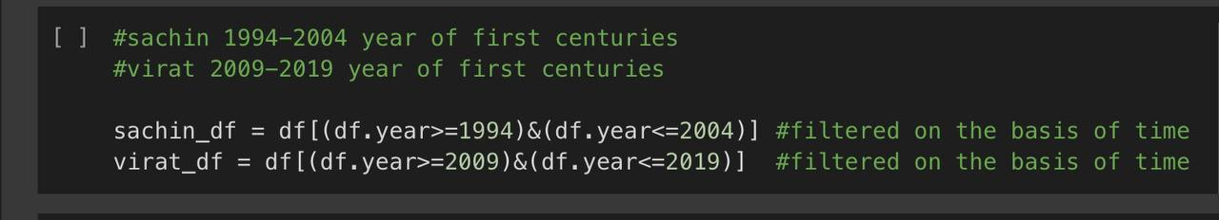
Years of Play Considered for comparison
Sachin Tendulkar – 1994 to 2004
Virat Kohli – 2009 to 2019
Reason – In 1994 Sachin Tendulkar had made his first century and for Virat Kohli his year of first century was 2009

Slide 4
KPI Values Obtained
Virat Kohli
Sachin Tendulkar
Innings Per Runs - 50.20
Strike Rate - 93.56
Centuries – 42
Half Centuries – 53
Team Contribution – 17.61%
Innings Per Runs – 43.60
Strike Rate – 88.21
Centuries – 37
Half Centuries – 57
Team Contribution – 16.95%

Slide 5
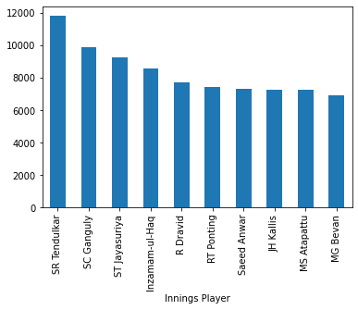
Top 10 Scorer’s during Sachin’s Time period
Top 10 Batsmen as per Total Runs Scored From 1994 to 2004
Sachin Tendulkar
Sourav Ganguly
Sanath Jayasuriya
Inzamam-ul-Haq
Rahul Dravid
Ricky Ponting
Saeed Anwar
Jacques Kallis
Marvan Atapattu
Michael Bevan
Runs

Slide 6
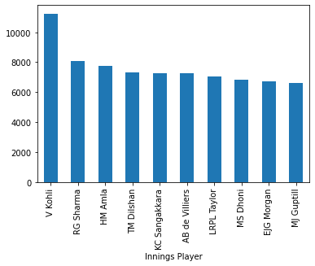
Top 10 Scorer’s during Virats’s Time period
Top 10 Batsmen as per Total Runs Scored From 1994 to 2004
Virat Kohli
Rohit Sharma
Hashim Amla
Tillakaratne Dilshan
Kumar Sangakkara
AB de Villiers
Ross Taylor
MS Dhoni
Eoin Morgan
Martin Guptill
Runs

Slide 7
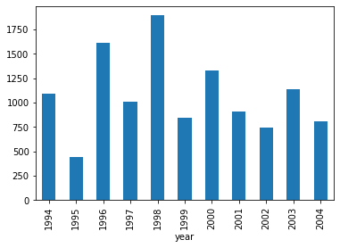
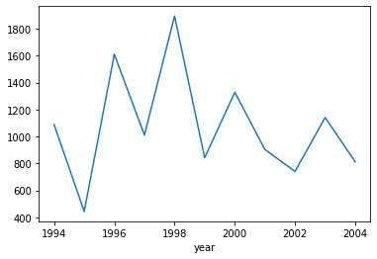
Sachin’s Performance Over the Year
As per the graph we can observe the Sachin’s Run’s scored are bit inconsistent.
For eg runs of 1995 are less than 1994. Similar observation can be drawn btwn the year 2002 and 2003
1998 is the year when he has scored the most runs
Runs
Runs

Slide 8
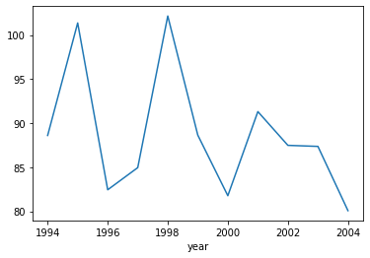
Strike Rate over the year
Same can be said for strike rate , with multiple maxima's and minima’s in graph his strike is also inconsistent
1998 is the year of highest strike rate
Strike Rate

Slide 9
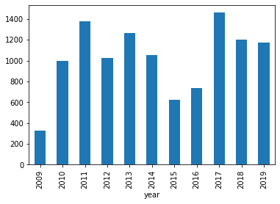
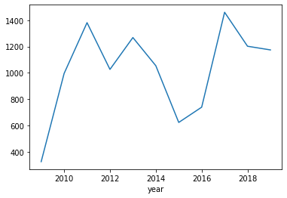
Virat’s Performance Over the Year
Runs
As per the graph we can observe the Virat’s Runs scored are less inconsistent in comparison to Sachin Tendulkar.
2009 is was the year of least number of runs
2017 is the year when he has scored the most runs
Runs

Slide 10
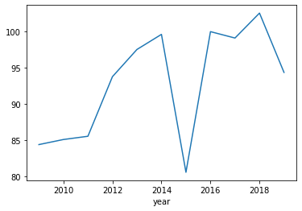
Strike Rate over the year
Strike rate of Virat over the year is more consistent than Sachin’s.
Has very less number of minima’s.
2015 is the year of lowest strike rate.
Strike Rate

Slide 11
Normalization
Definition – Ratio of values of data frame consisting of that particular player and values of data frame without that particular player
Example – (Runs per innings of virat kohli / Runs per innings of dataframe without virat kohli )
Virat Kohli
Sachin Tendulkar
Normalized Runs per Innings – 2.029
Normalized Strike Rate - 1.121
Normalized Runs per Innings – 1.943
Normalized Strike Rate - 1.219

Slide 12
Final Comparison
Virat Kohli
Sachin Tendulkar
Normalized Runs per Innings – 2.029
Normalized Strike Rate - 1.121
Centuries – 42
Half Centuries – 53
Team Contribution – 17.61%
Normalized Runs per Innings – 1.943
Normalized Strike Rate - 1.219
Centuries – 37
Half Centuries – 57
Team Contribution – 16.95%

Slide 13
On comparing the two players on the basis of five fields we can conclude that Virat Kohli is better than Sachin Tendulkar

